Slide 1
Introduction to Greek Theatre
Antigone
By
Sophocles

Slide 2
Origins of Greek Theatre
Celebrations to honor Dionysus, the god of wine
According to Greek mythology, he is the half mortal, half god son of Zeus
The cult of Dionysos celebrated the cycle of death and rebirth; they believed he inspired poets and artists to divine creativity

Slide 3
Structure of Greek Theatre
As Dionysian rituals became associated with dramatic productions, celebrations in his honor became much more formal and ceremonial
Theatre was a common bond among the Greek people; everyone attended and was familiar with the plays

Slide 4
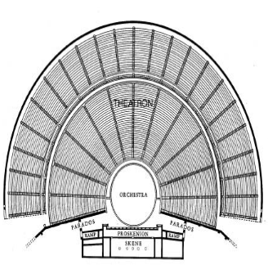

Slide 5
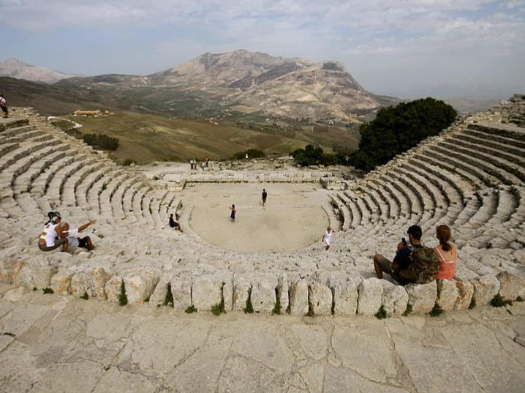

Slide 6
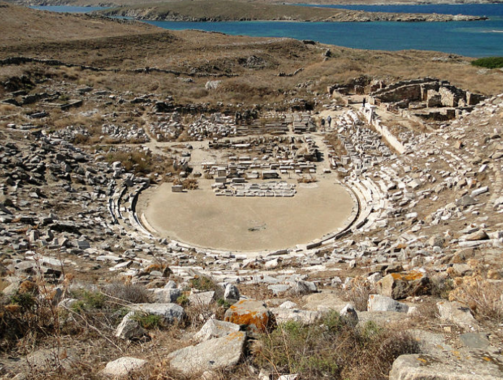

Slide 7
Structure of Greek Theatre
Orchestra
Literally the “dancing space”
Usually circular and level with the stage
Used as the place where the chorus would dance, sing, and interact with the actors on the stage

Slide 8
Structure of Greek Theatre
Theatron
Literally the “viewing place”
Spot where the spectators sat
Usually part of a hillside overlooking the orchestra
Spectators in the 5th century probably sat on cushions or boards; by the 4th century there were marble seats

Slide 9
Structure of Greek Theatre
Skene
Literally the “tent”
Building directly behind the stage
Usually decorated as a palace or temple
Had at least one set of doors for actors to make entrances and exits
Roof access used for playing Gods

Slide 10
Structure of Greek Theatre
Parados
Parodoi (singular)- literally the “passageways”
Paths by which the actors and actresses made entrances and exits
Audience also used them to enter and exit the theatre

Slide 11
Structure of Greek Plays
Prologue- Spoken by one or two characters before the chorus appears; usually gives the mythological background necessary for understanding the play
Parodos- song sung by the chorus as it first enters the orchestra

Slide 12
Structure of Greek Plays
First episode/scene- first of many “episodes” where the characters and chorus talk
First Strophe/Antistrophe- at the end of each episode, the characters leave the stage and the chorus sings and ode which works like a curtain to separate scenes
Exodus- chorus exits and sings a final song that comments on the play

Slide 13
The Chorus
Role of the Chorus is central to interpreting the plays
Lead by a single individual known as the choragos
Gives advices, questions, takes part
Establishes ethical framework
Ideal spectator- reacts as playwright hoped audience would

Slide 14
The Chorus
Adds movement, spectacle, song and dance
Rhythmical function- pauses/paces the action so the audience can reflect

Slide 15
Characteristics of Greek Tragedy
No violence takes place on stage, even though it is an integral part of the plot
Violent acts/ events are reported by a character on stage after the fact
Protagonist (main character) in conflict with the antagonist

Slide 16
Characteristics of Greek Tragedy
Catharsis- goal of the theatre is to provide an emotional release for the audience
-Pity is aroused as the hero meets his fate
-Fear is aroused since the audience could meet a similar fate
-The two emotions are eventually dispelled and a lesson is learned

Slide 17
Characteristics of Greek Tragedy
Tragic Heroes
Hamartia- usually translated as a tragic mistake or a tragic flaw
Hubris (exaggerated self pride or self confidence) is more often than not the cause of the downfall

Slide 18
Characteristics of Greek Tragedy
Religion
Greeks practiced polytheism- worship of many gods
They believed the quality of human life was dependant on the whims of the gods and the actions of people (either pleasing or angering the gods)
Death- for someone to move on to Hades (the underworld) they must be buried

Slide 19
Sophocles
Born in 496 BC
Well known in his time; won several competitions
Responsible for the Theban trilogy
  Oedipus Rex
  Oedipus at Colonus
  Antigone

Slide 20
The Oedipus Myth
Story of the plays was familiar to audiences; Antigone is the last in the trilogy
Oedipus is Antigone’s father
He was abandoned at birth because a fortuneteller predicted he would kill his father and marry his mother

Slide 21
The Oedipus Myth
The infant was supposed to be left for dead, but a sympathetic servant gave him to a childless couple
Ignorant of his origins, Oedipus kills his father, Laios (the King) and eventually becomes a hero in Thebes
  Sphinx’s Riddle: "What goes on four feet in the morning, two feet at noon, and three feet in the evening?"

Slide 22
The Oedipus Myth
Not knowing his true identity, Iocaste, widowed when Laios was killed, agrees to marry Oedipus (yes, her son!)
The couple lives happily and raises four children: Antigone, Ismene, Etocles, and Polyneices

Slide 23
The Oedipus Myth
A plague hits Thebes
During the investigation Oedipus learns the true facts of his birth
Iocaste commits suicide
Oedipus blinds himself & goes into exile

Slide 24
Antigone
Oedipus’ daughter, a strong female character
At the opening of the play, Creon (Iocaste’s brother) has taken control & restored order in Thebes
A war for control of Thebes ended when the Antigone’s brothers, Eteocles and Polyneices, killed each other in combat

